Slide 1




Interface Segregation / Dependency Inversion
Building Solid Code
Course Topic
SoftUni Team
Technical Trainers
Software University
http://softuni.bg

Slide 2

Table of Contents
Dependency Inversion
The Problem (Button → Lamp)
How to Invert Dependencies
Application Layering
Interface Segregation
"Fat" Interfaces vs "Role" Interfaces
Solving Problems

Slide 3
Questions
sli.do #java-fund

Slide 4
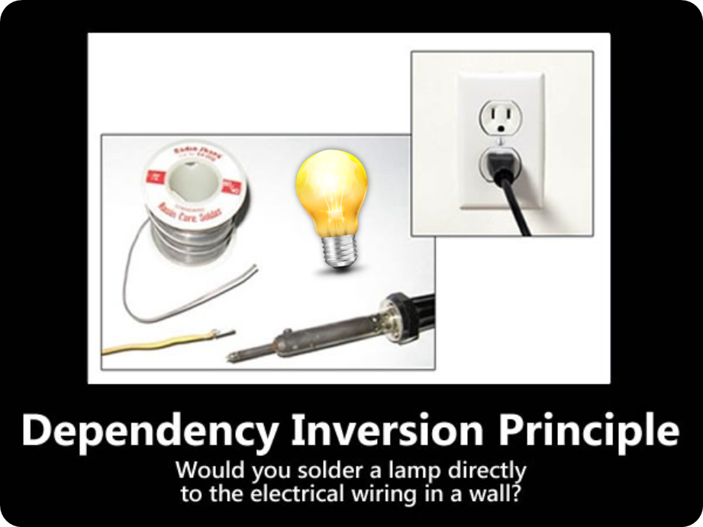
Dependency Inversion
Flip Dependencies

Slide 5
Dependency Inversion Principle
"Dependency Inversion Principle says that high-level modules should not depend on low-level modules. Both should depend on abstractions."
"Abstractions should not depend on details. Details should depend on abstractions."
Agile Principles, Patterns, and Practices in C#
Goal: decoupling between modules through abstractions

Slide 6
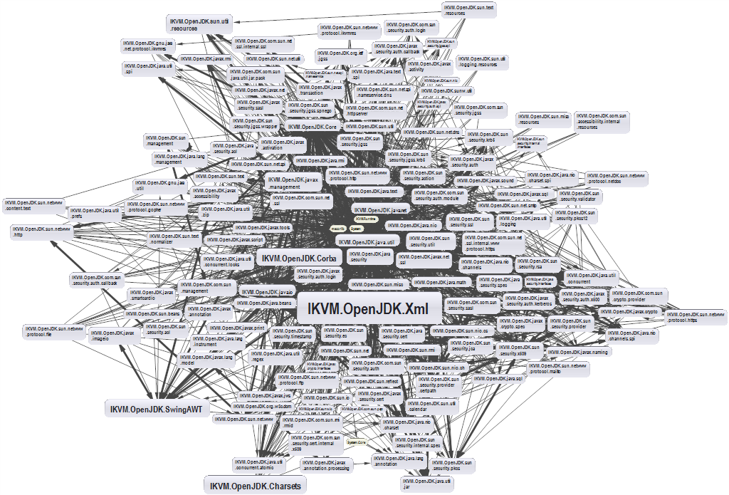
Dependencies and Coupling
What happens when modules depend directly on other modules

Slide 7
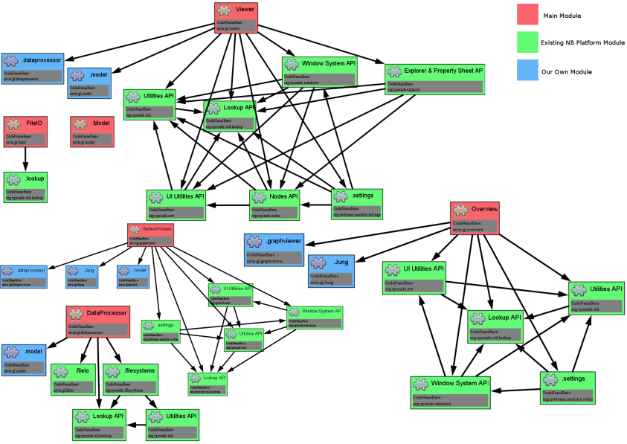
Dependencies and Coupling (2)
The goal is to depend on abstractions

Slide 8
The Problem
Button → Lamp Example – Robert Martin
Button depends on Lamp
High-level / Client
Lamp
turnOn()
turnOff()
Button
poll()
Low-level / Server

Slide 9
Dependency Inversion Solution
Find the abstraction independent of details
SwitchableDevice
<interface>
turnOn()
turnOff()
Button
poll()
uses
Client defines interfaces
implements
Lamp

Slide 10
Dependency Examples
A dependency is any external component / system:
Framework
Third party library
Database
File system
Email
Web service
System resource (e.g. clock)
Configuration
The new keyword
Static method
Global function
Random generator
System.in / System.out

Slide 11

How to DIP?
Constructor injection
Dependencies are passed through constructors
Pros
Classes self-documenting requirements
Works well without container
Always valid state
Cons
Many parameters
Some methods may not need everything

Slide 12
Constructor Injection – Example
public class Copy {
private Reader reader;
private Writer writer;
public Copy(Reader reader, Writer writer) {
this.reader = reader;
this.writer = writer;
}
public void copyAll() {}
}

Slide 13
How to DIP? (2)
Setter Injection
Dependencies are passed through setters
Pros
Can be changed anytime
Very flexible
Cons
Possible invalid state of the object
Less intuitive

Slide 14
Setter Injection – Example
public class Copy {
private Reader reader;
private Writer writer;
public void setReader(Reader reader) {}
public void setWriter(Writer writer) {}
public void copyAll() {}
}

Slide 15
How to DIP? (3)
Parameter injection
Dependencies are passed through method parameters
Pros
No change in rest of the class
Very flexible
Cons
Many parameters
Breaks the method signature
public class Copy {
public copyAll(Reader reader, Writer writer) {}
}

Slide 16

Problem: System Resources
You are given a GreetingClock
if hour < 12, prints "Good morning…"
if hour < 18, prints "Good afternoon…"
else prints "Good evening…"
Refactor so it conforms to DIP
* Introduce Strategy Design Pattern

Slide 17
Solution: System Resources
Inject interfaces TimeProvider and Writer
<TimeProvider>
+getHour():int
GreetingClock
+greet():void
uses
<Writer>
+println(String):void

Slide 18
Problem: Services
You are given some classes
Follow DIP to invert dependencies
*Introduce Composite Design Pattern
SmsNotificationService
+isActive():Boolean
+sendNotification():void
OnlineStoreOrder
+process():void
uses
EmailNotificationService
+isActive():Boolean
+sendNotification():void

Slide 19
Solution: Services
<NotificationService>
+isActive():Boolean
+sendNotification():void
OnlineStoreOrder
+process():void
EmailNotificationService
EmailNotificationService

Slide 20
Layering
Traditional programming
High-level modules use low-level modules
UI Layer
Business Layer
Data Access Layer

Slide 21
Layering (2)
Dependency Inversion Layering
High and low-level modules depend on abstractions
Client defines interfaces
UI Layer
<BL Interface>
Business Layer
<DAL Interface>
Data Access Layer

Slide 22
Problem: Employee Info
You are given some classes
Refactor the code so that it conforms to DIP
Main
ConsoleFormatter
EmployeeInfoProvider
EmployeeDatabase

Slide 23
Solution: Employee Info
ConsoleClient
<Formatter>
<InfoProvider>
ConsoleFormatter
EmployeeInfoProvider
<Database>
EmployeeDatabase

Slide 24

Dependency Inversion Principle
Live Exercises in Class (Lab)

Slide 25
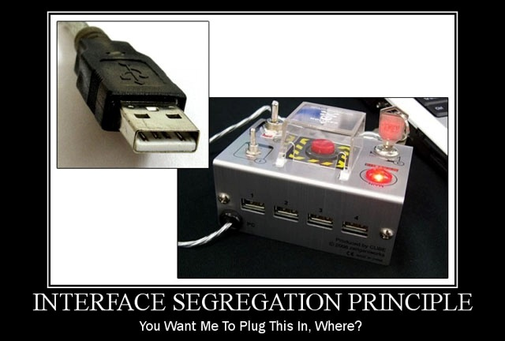
Interface Segregation
Clients Require Cohesive Interfaces

Slide 26
ISP – Interface Segregation Principle
"Clients should not be forced to depend on methods they do not use."
Agile Principles, Patterns, and Practices in C#
Segregate interfaces
Prefer small, cohesive interfaces
Divide "fat" interfaces into "role" interfaces

Slide 27
Fat Interfaces
Classes whose interfaces are not cohesive have "fat" interfaces
public interface Worker {
void work();
void sleep();
}
Class Employee is OK
public class Robot implements Worker {
void work() {}
void sleep() {
throw new UnsupportedOperationException();
}
}

Slide 28

"Fat" Interfaces
Having "fat" interfaces:
Classes have methods they do not use
Increased coupling
Reduced flexibility
Reduced maintainability

Slide 29
How to ISP?
Solutions to broken ISP
Small interfaces
Cohesive interfaces
Let the client define interfaces – "role" interfaces

Slide 30
Cohesive Interfaces
Small and Cohesive "Role" Interfaces
public interface Worker {
void work();
}
public interface Sleeper {
void sleep();
}
public class Robot implements Worker {
void work() {
// Do some work…
}
}

Slide 31
Problem: Recharge
You are given some classes
Refactor the code so that it conforms to ISP
* Consider the case that you don't own the library
New feature
Recharge Station
<Rechargeable>
(A) Worker
Current library
Employee
Robot

Slide 32
Solution: Rechargeable
Multiple Inheritance (If you own the library)
Recharge Station
<Rechargeable>
<Sleeper>
(A) Worker
Robot
Employee

Slide 33
Solution: Rechargeable (2)
Adapter Pattern (If you don't own the library)
Recharge Station
<Rechargeable>
(A) Worker
RobotAdapter
Robot
Employee

Slide 34
Problem: Security Door
You are given some classes
Refactor the code so that it conforms to ISP
(A) SecurityCheck
KeyCardCheck
PinCodeCheck
<SecurityUI>
+requestKeyCard():String
+requestPinCode():int

Slide 35
Solution: Security Door
(A) SecurityCheck
KeyCardCheck
PinCodeCheck
<KeyCardUI>
+requestKeyCard():String
<PinCodeUI>
++requestPinCode():int
<SecurityUI>

Slide 36
Summary
Use dependency injection and abstractions
High and low-level modules should depend on abstractions
Abstractions should not depend on details
Let the client define the interfaces
Prefer "role" interfaces

Slide 37












Java Advanced – Course Overview
https://softuni.bg/courses/java-oop-advanced

Slide 38





Trainings @ Software University (SoftUni)
Software University – High-Quality Education, Profession and Job for Software Developers
softuni.bg
Software University Foundation
http://softuni.foundation/
Software University @ Facebook
facebook.com/SoftwareUniversity
Software University Forums
forum.softuni.bg

Slide 39

License
This course (slides, examples, demos, videos, homework, etc.) is licensed under the "Creative Commons Attribution-NonCommercial-ShareAlike 4.0 International" license
Attribution: this work may contain portions from
"Fundamentals of Computer Programming with Java" book by Svetlin Nakov & Co. under CC-BY-SA license
"C# Part I" course by Telerik Academy under CC-BY-NC-SA license
"C# Part II" course by Telerik Academy under CC-BY-NC-SA license

